Slide 1
COMPUTER AIDED SKIN DISEASE CLASSIFICATION USING CNN
1MJ17CS006-Aditya B
1MJ17CS013-Allen Mathews
1MJ17CS014-Amal Nair
1MJ17CS019-Ankith R
Guide: Swathika R, Asst. Prof, CSE
Dr. S. Anthony Raj, Asst. Prof, CSE

Slide 2
Contents
Objectives
Problem statement
Existing Systems
Proposed System
Architecture
Diagrams
Implementation status
Publication status

Slide 3
Objectives
The motivation for this proposed system is that:
Most other models used in the previous works are usually very large and can take a lot of time to process predictions and usually need a lot processing power to do so. However, such a model is rather impractical to be deployed. Our objective is to make a model which is reliable as well as lightweight enough to be deployed in real world environments.

Slide 4
Problem Statement
To develop a lightweight model to classify skin lesions which is reliable enough to be used in real world scenarios and use it to develop mobile or embedded vision applications where this model can be deployed.

Slide 5
Existing systems
Most of the existing systems use a combinations of very large and complex models.
These large models are favoured for their higher accuracy rates.
These models sacrifice deployability for this higher level of accuracy. This means that most of the existing systems cannot be deployed as an application as they would perform badly on mobile systems like laptops or smartphones.
This makes them unfeasible for real world use in hospitals.
These systems did not augment any new data that could help imporve the performance of the models. More variations of the existing data can help the model be more prepared for lesions it has never seen before.

Slide 6
Proposed system
We propose to use a modified version of a pretrained model called MobileNet.
MobileNet is a very lightweight model which is very suitable for smaller systems which do not have the processing power to run the commonly used large nets.
We use a ImageDataGenerator to create extra data to be augmented into the existing dataset. A combination of modifications such as rotation, width shift, height shift, flipping horizontally or vertically, and zooming in or out was used to produce the new images.
MobileNet has 93 layers and we train the last 23 of them.
We also reduce the dropout ratio for the last 6 layers to prevent overfitting.
Finally the last output layer is changed to be a 7 output dense layer. 7 outputs are used because we have 7 classes in the dataset.

Slide 7
Lesion classes in dataset
Actinic keratoses (also called solar keratoses) are dry scaly patches of skin that have been damaged by the sun. The patches are not usually serious. But there's a small chance they could become skin cancer, so it's important to avoid further damage to your skin.
Basal cell carcinoma is a type of skin cancer that most often develops on areas of skin exposed to the sun. This photograph shows a basal cell carcinoma that affects the skin on the lower eyelids.
Skin growths that some people develop as they age. They often appear on the back or chest, but can occur on any part of the body. It grow slowly, in groups or singly. Most people will develop at least one seborrheic keratosis during their lifetime.

Slide 8
Lesion classes in dataset
Dermatofibroma is a common cutaneous nodule of unknown etiology that occurs more often in women. It develops on the extremities and is usually asymptomatic.
Melanoma is a form of skin cancer that begins in the cells which control the pigment of your skin. Symptoms include unusual growth change of an existing mole and can occur anywhere on the body.
Melanocytic nevi are benign neoplasms of melanocytes and appear in a myriad of variants, which all are included in our series. The variants may differ significantly from a dermatoscopic point of view.
Vascular lesions are relatively common abnormalities of the skin and underlying tissues, most commonly birthmarks.

Slide 9
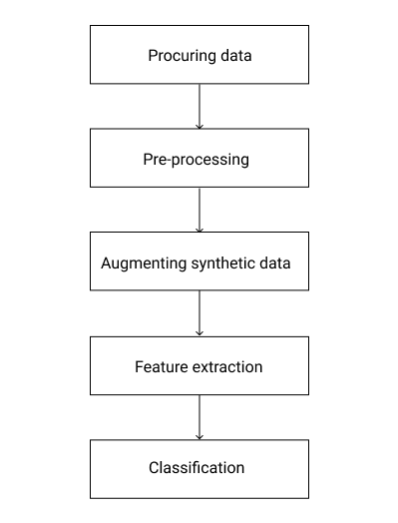
Architecture

Slide 10
Architecture
The system can be broadly categorized into following major phases:
Procuring dataset: The images are acquired either through camera or through locally stored device.
Pre-Processing: The image is standardized in this phase by resizing the images to a smaller size. The size should neither be too small since that would lead to a lot of losses in the image data and nor too large as the training would take too long and the predictions will be very slow on user’s systems.

Slide 11
Architecture
3. Augmenting synthetic data: An image generator is used to randomly modify the existing images to make synthetic data to be augmented with the actual dataset. A combination of width modification, height modification, rotation, zooming in or out, and flipping the images horizontally or vertically.
4. Deep feature extraction and classification: MobileNet is a pretrained model. MobileNets are based on a streamlined architecture that uses depth-wise separable convolutions to build light weight deep neural networks. There are 93 layers and we train the last 23 layers with our dataset. The dropout rate of the last 6 layers is reduced and the final output layers is modified to be a dense layer with 7 outputs corresponding to the number of classes in the problem.

Slide 12
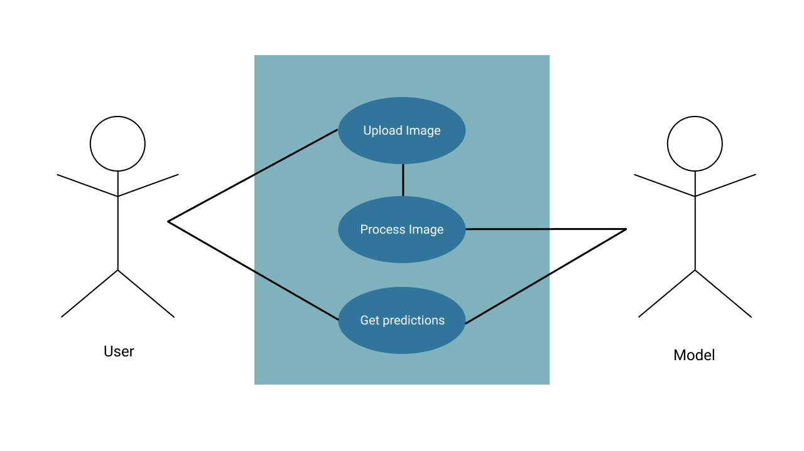
Use case diagram

Slide 13
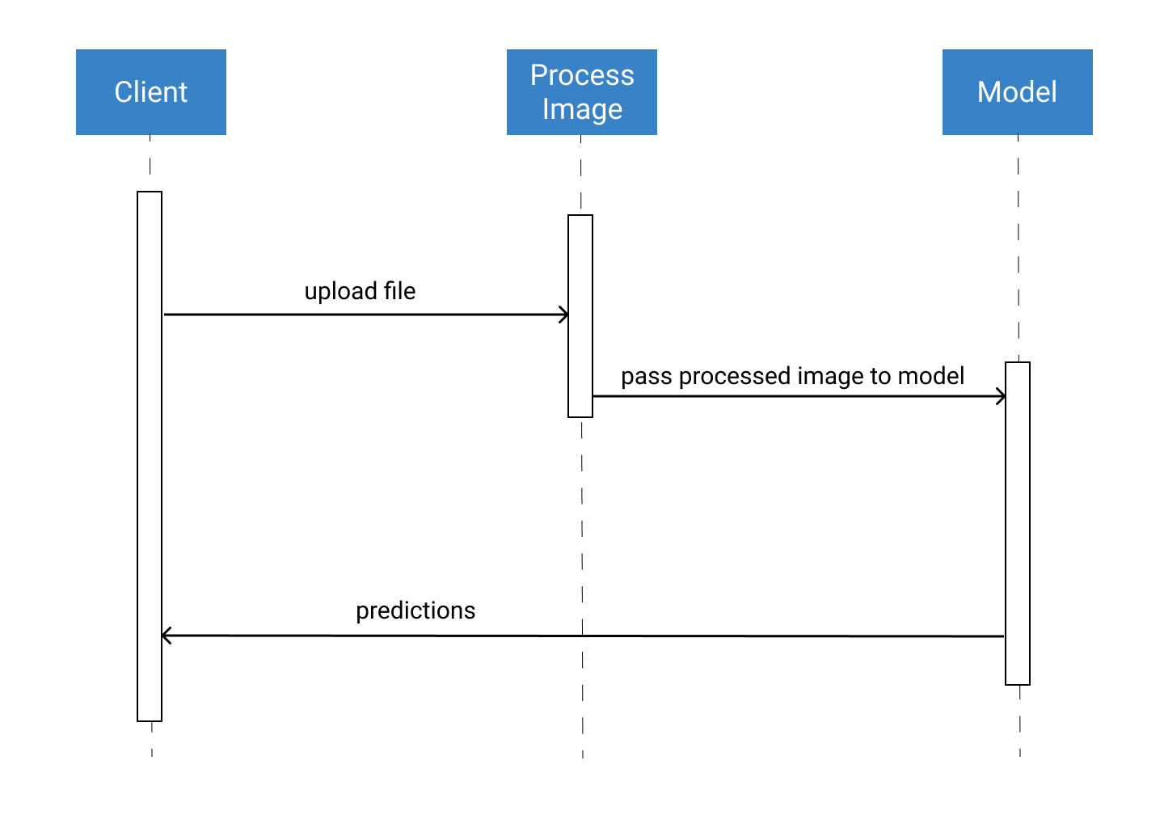
Sequence Diagram

Slide 14
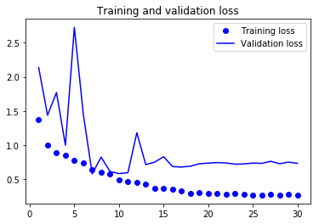
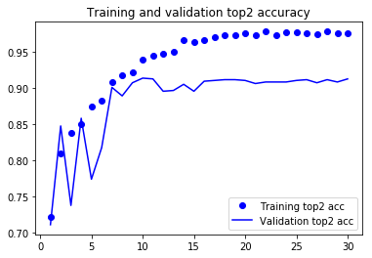
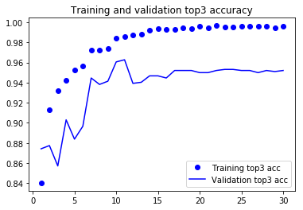
Implementation status

Slide 15
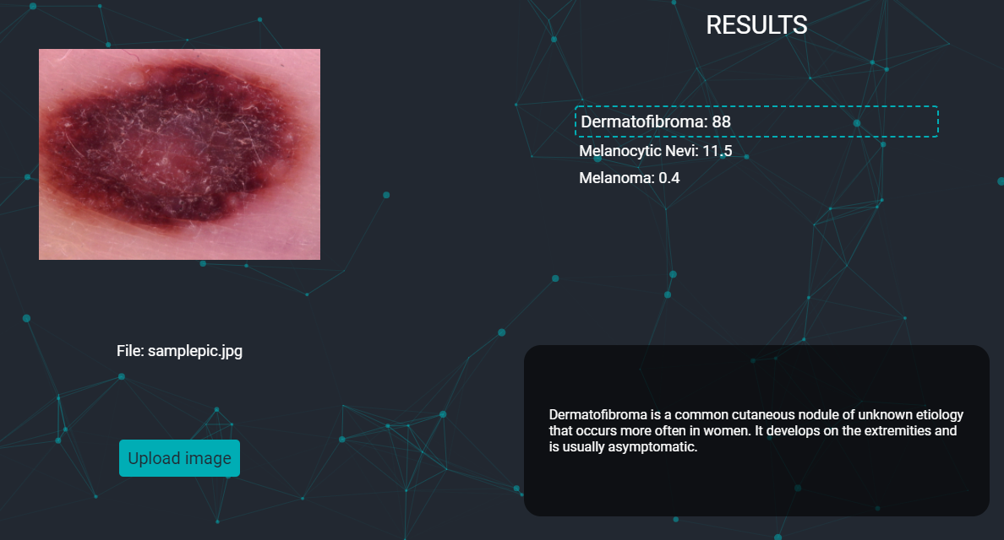
Implementation status

Slide 16
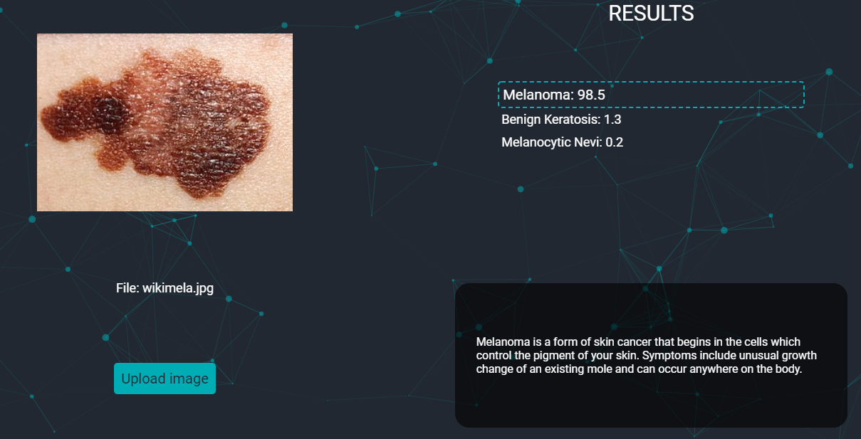
Implementation status

Slide 17
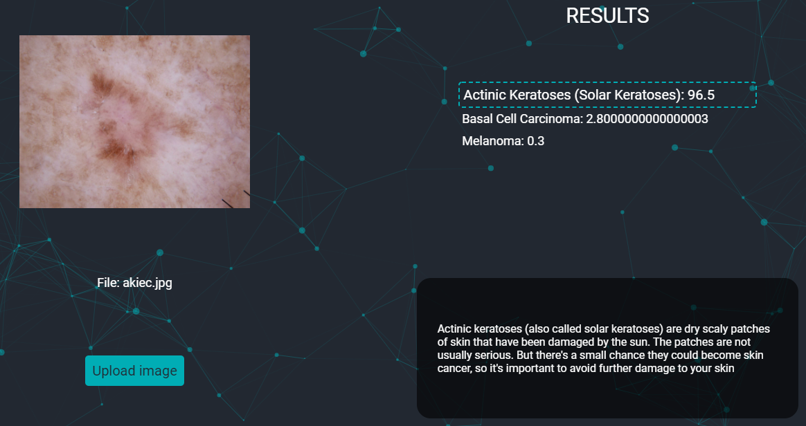
Implementation status

Slide 18
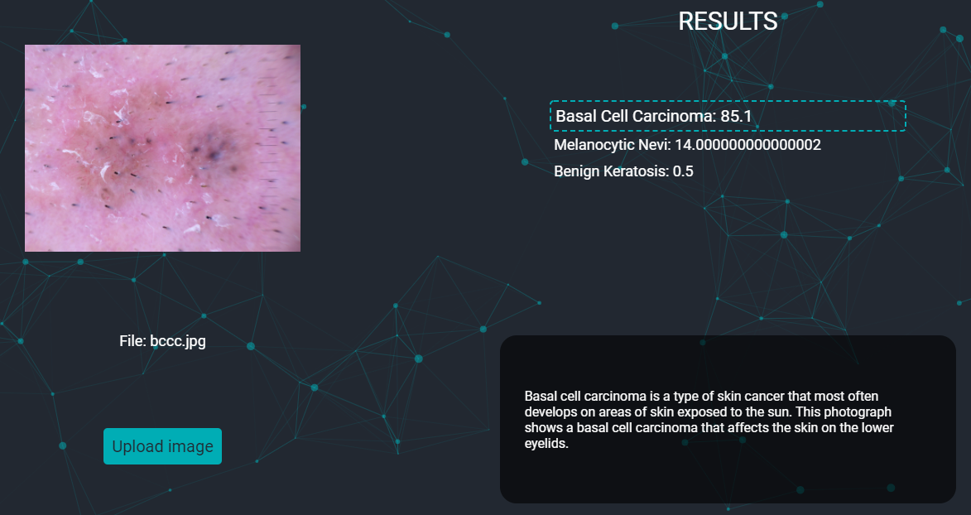
Implementation status

Slide 19
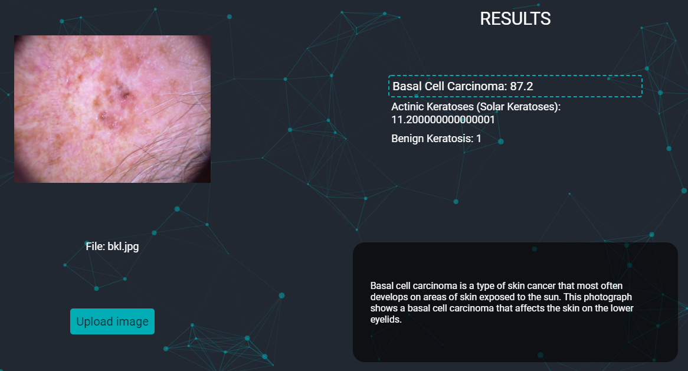
Implementation status

Slide 20
THANK YOU

